Slide 1

Machine Learning Presentation
Reducing Customer Churn Using Predictive Analytics
A Strategic Approach to Enhancing Customer Retention
Joshua Au-Yeung, Metodi Baniski, Dawood Cheema, Dmitry Esaulov, Alkarim Assar
Group 5
December 4th, 2024

Slide 2

Customer churn is a major challenge in subscription-based industries.
Retaining existing customers is more cost-effective than acquiring new ones.
Proactively identifying at-risk customers helps businesses take action to reduce churn.
Customer Churn Problem
Notes:
"Customer churn is a critical challenge faced by many industries, particularly in subscription-based businesses such as telecommunications, SaaS, and retail.“
"In these industries, retaining customers is more cost-effective than acquiring new ones. Therefore, understanding and predicting churn is essential for profitability.“
"Our focus is on identifying customers who are most likely to churn, so businesses can take proactive steps to retain them and reduce churn-related costs."

Slide 3
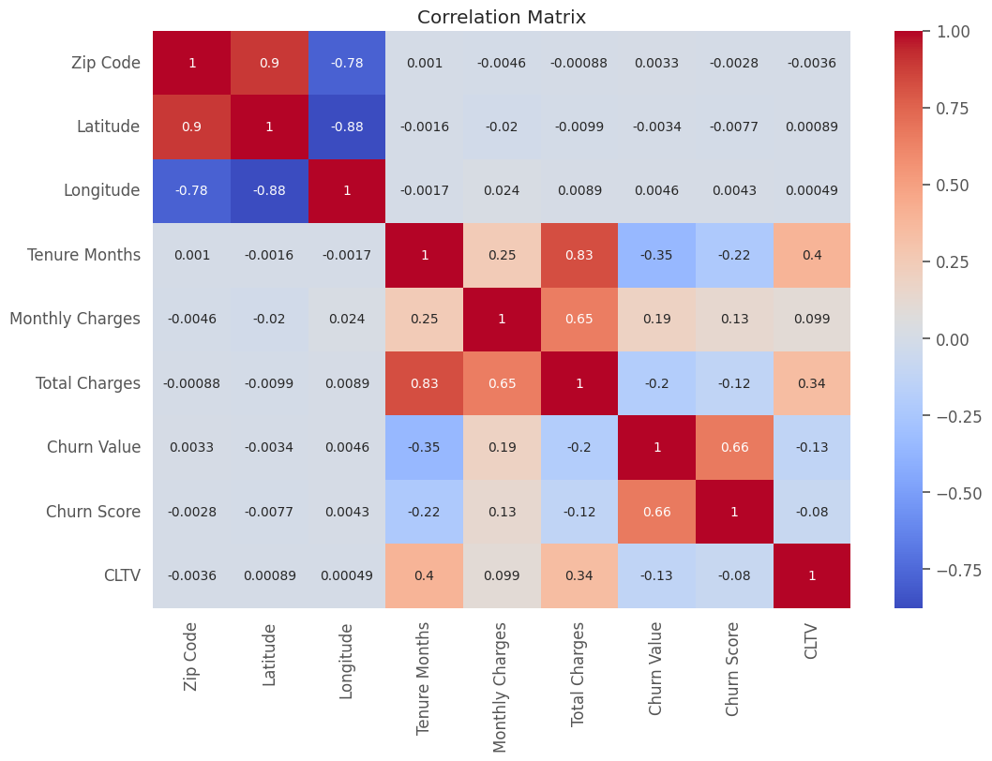
Dataset & Correlational Matrix
Dataset: IBM fictional dataset of telco customers.
Size: 7,043 rows and 33 columns.
Outcome: Binary classification problem: churn (1) or no churn (0).
Redundant: Removed redundant columns (e.g., zip code, churn reason).
Handled class imbalance with stratified sampling.
Notes:
"The dataset contains various customer attributes, such as demographics, account details, usage behavior, and service engagement.“
"Key features in the dataset include:
Customer Age: Impacts engagement levels.
Account Type: Influences retention rates.
Tenure: The length of time the customer has been with the company, which correlates with churn probability.
Monthly Spend: A predictor of customer satisfaction and loyalty.
Service Usage: Frequency of service usage can reveal potential dissatisfaction."
"Our goal is to use these features to predict the likelihood of a customer churning."

Slide 4
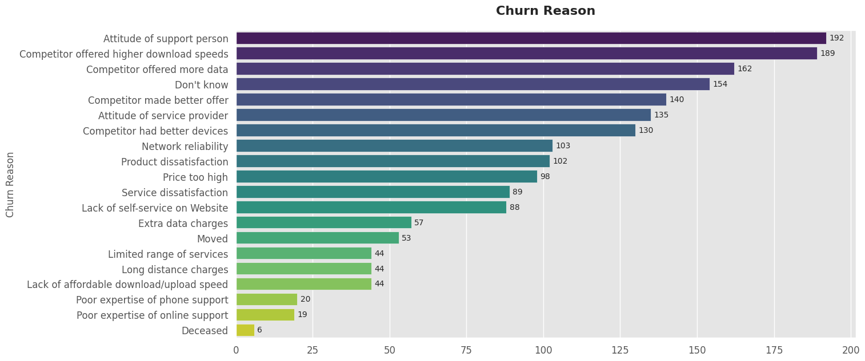
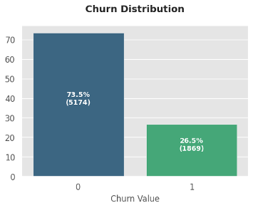
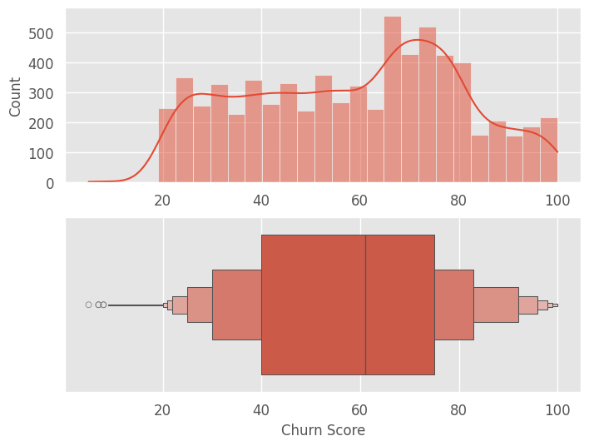
Dataset Exploration, Features and Analysis
The dataset includes customer attributes like demographics, account details, and usage behavior to predict churn likelihood.
Customer Age: Impacts engagement levels
Account Type: Influences retention rates
Tenure: Correlates with churn probability
Monthly Spend: Indicates customer satisfaction and loyalty
Service Usage: Reveals potential dissatisfaction
Notes:
"The dataset contains various customer attributes, such as demographics, account details, usage behavior, and service engagement.“
"Key features in the dataset include:
Customer Age: Impacts engagement levels.
Account Type: Influences retention rates.
Tenure: The length of time the customer has been with the company, which correlates with churn probability.
Monthly Spend: A predictor of customer satisfaction and loyalty.
Service Usage: Frequency of service usage can reveal potential dissatisfaction."
"Our goal is to use these features to predict the likelihood of a customer churning."

Slide 5
Our Approach to Predicting Churn
Model Selection
Logistic Regression
Random Forest
Gradient Boosting
XGBoost
LightGBM
SVC
AdaBoost
KNN
Decision Trees.
Data Preparation
Top performers
Fine-tuning & Evaluation
Handling missing values, encoding categorical data, and scaling numerical features.
Gradient Boosting (ROC-AUC: 0.8603)
Logistic Regression (0.8568)
LightGBM (0.8536).
Gradient Boosting
LightGBM
Logistic Regression
AdaBoost.
Grid search for hyper parameter optimization.

Slide 6
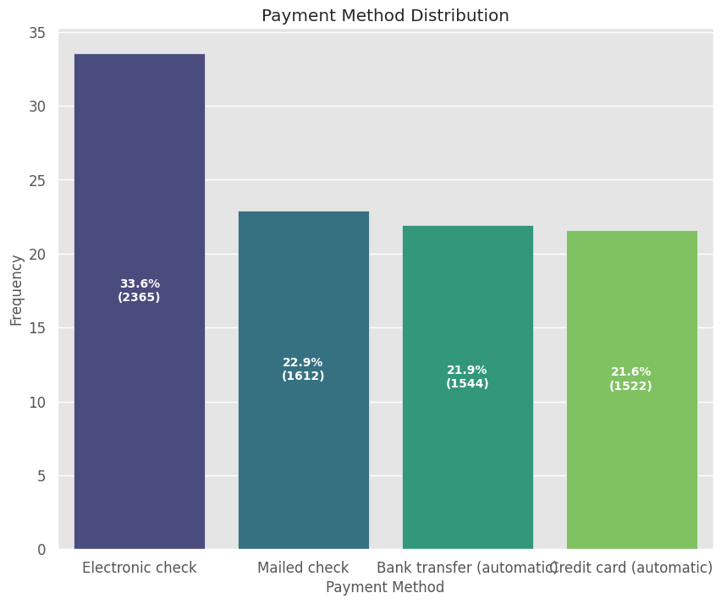
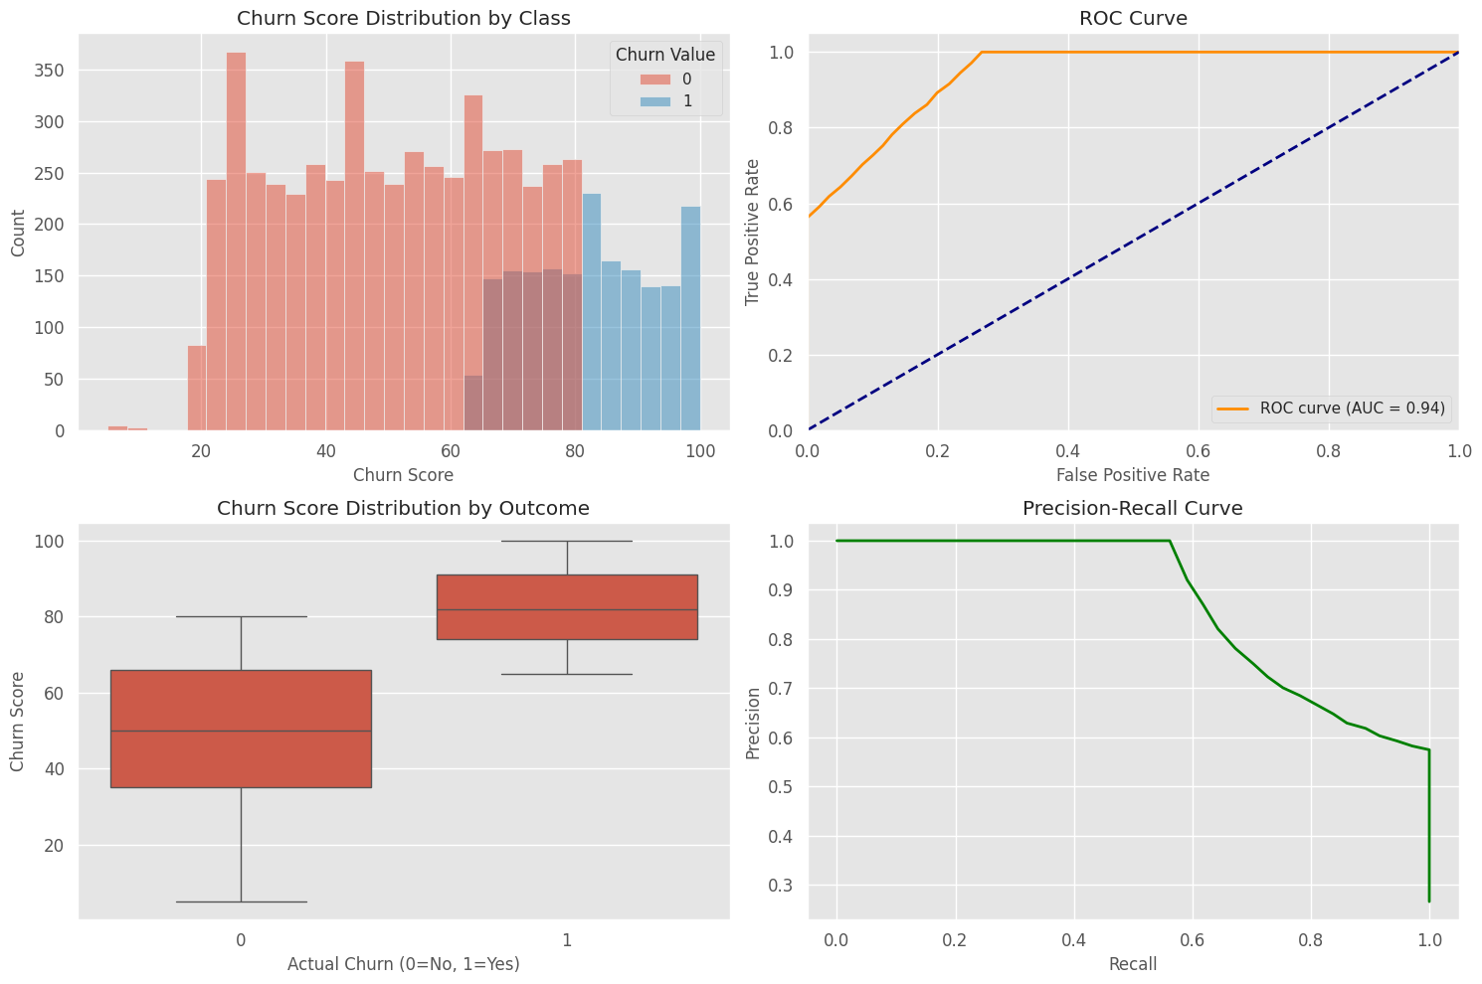
Key Model Results and Insights
Top Model Performance
XGBoost and Gradient Boosting were the best performers, achieving ROC AUC and recall scores above 0.94.
Key Insights from the Model
Logistic Regression Baseline
Key Churn Drivers
Churn in Long Tenure

Slide 7
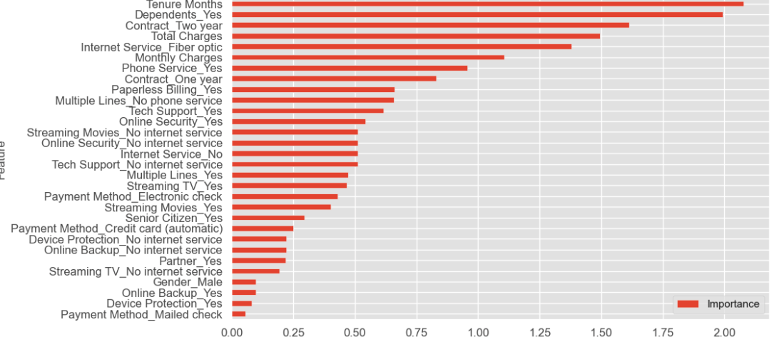
Feature Importance
Long-term customers tend to stay that way. Also 1 or 2-year contracts obviously work for their duration.

Slide 8
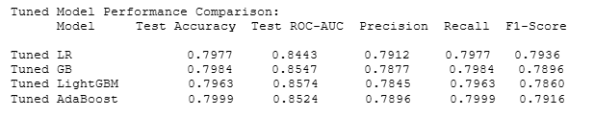
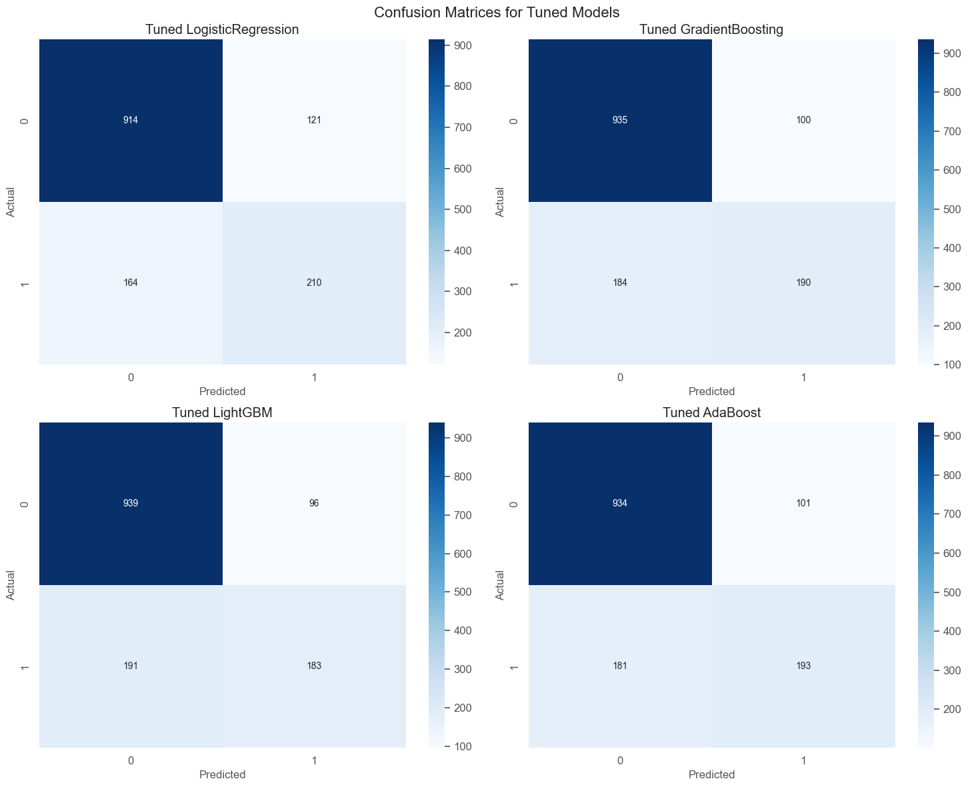
Fine-Tuning and Results
Fine-tuning top models:
Gradient Boosting, LightGBM, Logistic Regression, AdaBoost.
Grid search for hyperparameter optimization.
Results:
AdaBoost achieved highest accuracy (0.7999).
LightGBM showed most improvement post-tuning.
We fine-tuned the top models and found AdaBoost to perform best overall, while LightGBM showed significant gains from tuning.

Slide 9

Business Strategy 1 – Targeted Retention Campaigns
One of the key strategies to reduce churn is to run targeted retention campaigns for at-risk customers.
Using the churn prediction model, businesses can identify customers with a high likelihood of leaving and target them with personalized offers, discounts, or loyalty programs.
For instance, offering a discount on the next purchase or providing exclusive content to users with long tenure but low engagement could significantly improve retention.
Notes:
"One of the key strategies to reduce churn is to run targeted retention campaigns for at-risk customers.“
"Using the churn prediction model, businesses can identify customers with a high likelihood of leaving and target them with personalized offers, discounts, or loyalty programs.“
"For instance, offering a discount on the next purchase or providing exclusive content to users with long tenure but low engagement could significantly improve retention."

Slide 10

Business Strategy 2 – Proactive Customer Support
A proactive approach to customer support is essential for retaining customers who may be dissatisfied with the service.
We recommend using the churn prediction model to flag at-risk customers and assign them to dedicated customer success teams who can resolve issues before they lead to churn.
For example, customers who have expressed dissatisfaction with service usage but have been with the company for a long period can be offered personalized support or service upgrades.
Notes:
"A proactive approach to customer support is essential for retaining customers who may be dissatisfied with the service."
"We recommend using the churn prediction model to flag at-risk customers and assign them to dedicated customer success teams who can resolve issues before they lead to churn."
"For example, customers who have expressed dissatisfaction with service usage but have been with the company for a long period can be offered personalized support or service upgrades."

Slide 11

Business Strategy 3 – Price Optimization
One way to mitigate churn and increase revenue is through dynamic price optimization.
By using the churn prediction model, we can predict the optimal price for each customer based on their likelihood of churning and their willingness to pay.
Customers who are at risk of churning but have high willingness to pay could be offered a slightly increased price, while those with lower engagement could be offered discounts to retain them.
Notes:
"One way to mitigate churn and increase revenue is through dynamic price optimization.“
"By using the churn prediction model, we can predict the optimal price for each customer based on their likelihood of churning and their willingness to pay.“
"Customers who are at risk of churning but have high willingness to pay could be offered a slightly increased price, while those with lower engagement could be offered discounts to retain them."

Slide 12



Future State Model – Customer-Specific Pricing
We propose a future state model that not only predicts churn but also determines the optimal price.
Incorporating additional features, we can develop a pricing strategy.
This model will allow businesses to tailor their pricing to individual customers.
Notes:
"Looking ahead, we propose a future state model that not only predicts churn but also determines the optimal price for each customer.“
"By incorporating additional features like customer feedback, usage patterns, and external factors (e.g., market trends), we can develop a pricing strategy that minimizes churn while maximizing revenue.“
"This model will allow businesses to tailor their pricing to individual customers, increasing customer satisfaction and profitability."

Slide 13

Conclusion and Next Steps
In conclusion, the machine learning model we built provides businesses with valuable insights into predicting churn and implementing strategies to retain at-risk customers.
Implement retention strategies discussed
Refine the churn prediction model with more features.
Develop a customer-specific pricing model to enhance retention and increase revenue.
Notes:
"In conclusion, the machine learning model we built provides businesses with valuable insights into predicting churn and implementing strategies to retain at-risk customers.“
"Our next steps include implementing the retention strategies discussed, as well as further refining the churn prediction model with more features.“
"In the long term, we will focus on developing a customer-specific pricing model to further enhance retention and increase revenue."

Slide 14

Thank You
Joshua Au-Yeung, Metodi Baniski, Dawood Cheema, Dmitry Esaulov, Alkarim Assar
aka Group 5

